Slide 1
Università degli Studi di Bologna – Sede di Forlì April 29th, 2014
Russia, Ukraine and the European Energy Security
Matteo Verda Istituto per gli Studi di Politica Internazionale - Milano

Slide 2
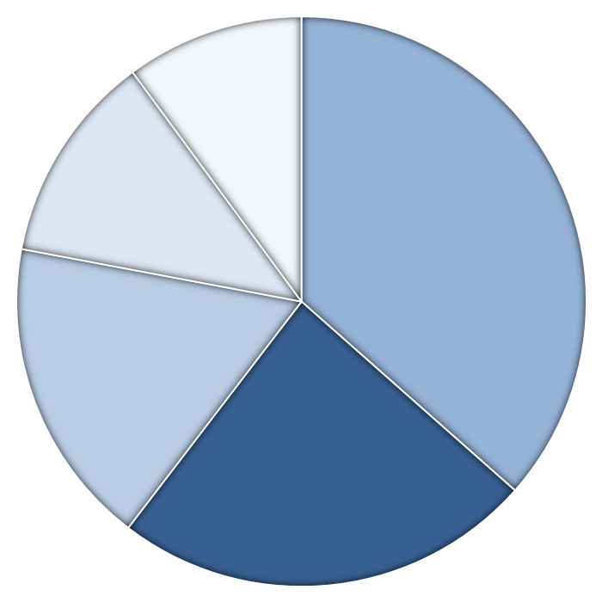
EU energy mix
renewables 12%
nuclear 12%
oil 36%
coal 18%
natural gas 24%
2012 – Source: BP, Statistical Review of World Energy 2013.

Slide 3
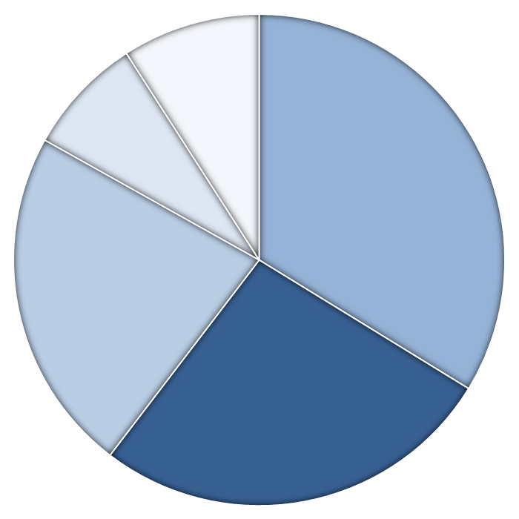
EU natural gas supply
others
39 Bcm (9%)
Algeria 36 Bcm
(8%)
EU domestic production 156 Bcm (33%)
Norway
105 Bcm (23%)
Russian Federation 126 Gmc
(27%)
2013 – EU total: 462 Bcm. Source: Eurogas, Drop in 2013 EU gas demand emphasises need for swift change.

Slide 4
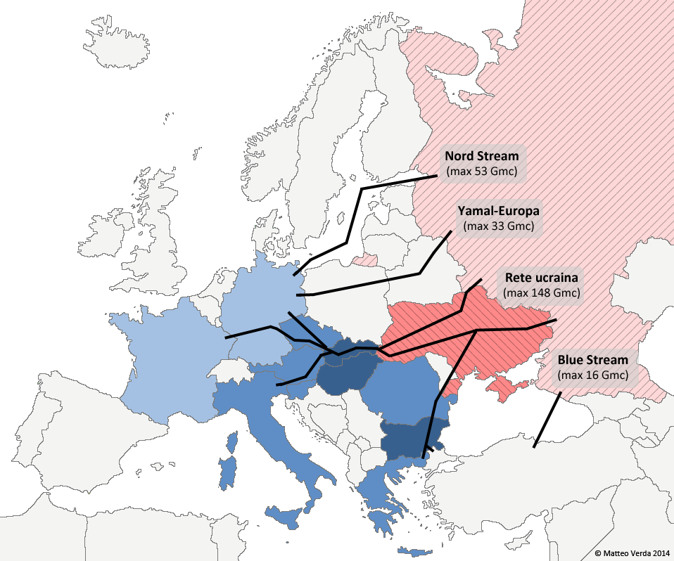
Export infrastructures and Ukrainian transit dependence

Slide 5
Russian Customers
 | imports from Russia^{A} | transit through Ukraine^{B} | share of Ukrainian transit | Russian gas / gas consumption^{C} | Gas / energy consumption^{D}
Italy | 24,1 | 24,1 | 100% | 29% | 38%
Germany | 38,2 | 11,1 | 29% | 37% | 22%
Czech Rep. | 7,0 | 7,0 | 100% | 57% | 18%
Hungary | 5,7 | 5,7 | 100% | 80% | 40%
Slovakia | 5,1 | 5,1 | 100% | 84% | 32%
Austria | 5,0 | 5,0 | 100% | 60% | 25%
France | 7,8 | 3,0 | 38% | 16% | 16%
Bulgaria | 2,6 | 2,6 | 100% | 89% | 14%
Greece | 2,5 | 2,5 | 100% | 56% | 13%
Romania | 1,1 | 1,1 | 100% | 24% | 36%
Slovenia | 0,5 | 0,5 | 100% | 60% | 10%
others | 26,9 | 0,0 | - | 11% | 24%
EU | 126,5 | 67,7 | 54% | 24% | 24%
Sources: A – (2013, Bcm) Gazprom Export and Eurogas; B – (2013, Bcm) Pirani (2014); C – (2012) Eurogas; D – (2012) BP.

Slide 6
Russia-Europe natural gas export infrastructures
 |  | Transit Countries | Max. (daily) Mcm | Max (yearly) Gcm
Ukrainian gas system | Slovakia, Hungary, Romania, Poland | Ukraine | 452 | 148
Nord Stream | Germany | - | 160 | 53
Yamal-Europa | Poland | Belarus | 102 | 33
Blue Stream | Turkey | - | 49 | 16
total (main pipelines) |  |  | 763 | 250
Minor pipelines | Estonia, Finlandia Lettonia, Lituania | - | 103 | 34
total (Europe) |  |  | 866 | 284
2013 – Implied yearly functioning rate 90%. Source: elaboration on ENTSOG/GIE.

Slide 7
Ukrainian export capacity
 | Max. (daily) Mcm | Max (yearly) Gcm
Slovakia | 281 | 92
Romania | 103 | 34
Hungary | 55 | 18
Poland | 12 | 4
total | 451 | 148
2013 – Implied yearly functioning rate 90%. Source: elaboration on ENTSOG/GIE.

Slide 8
Eastern Europe storage capacity
 | Capacity Mcm (march 2014) | Days of counsumption (est.)
Bulgaria | 200 | 31
Slovakia | 1.000 | 66
Hungary | 1.200 | 51
Ukraine | 11.500 | 93
2013 – Source: elaboration on GIE, Eurogas.

Slide 9
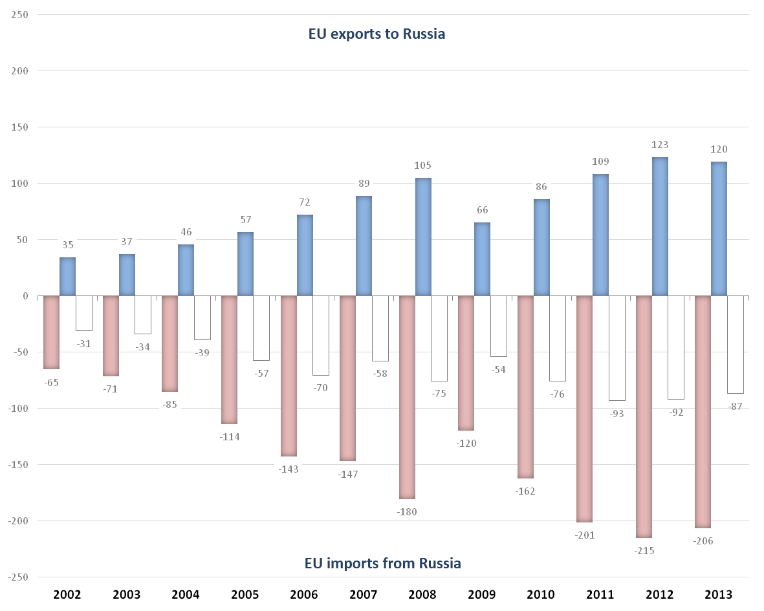
EU-Russia trade
€ Bn
Source: Eurostat, ext_st_eu28sitc

Slide 10
Russian Exports
others 33%
oil and oil products
54%
$ 170 bn
$ 285 bn
$ 69 bn
gas
13%
Total: $ 524 bn (€ 380 bn)
2012 – UNCOMTRADE, online database

Slide 11
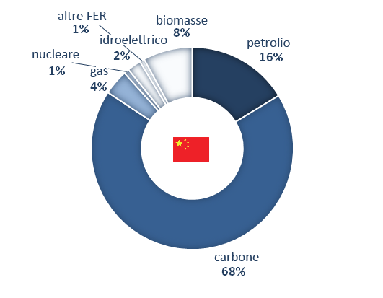
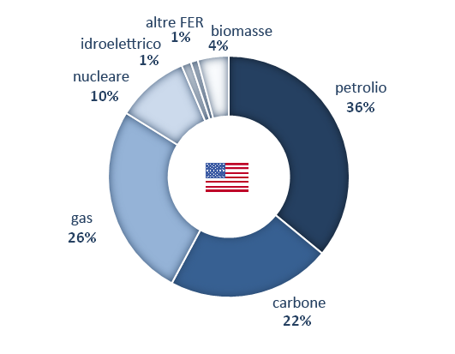
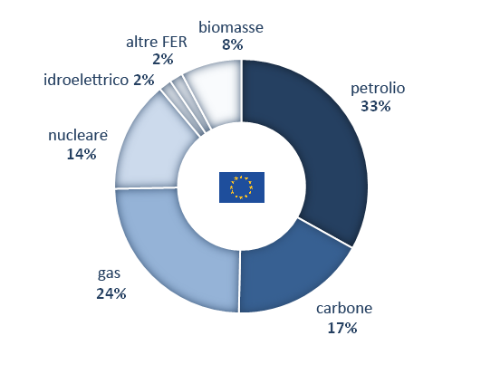
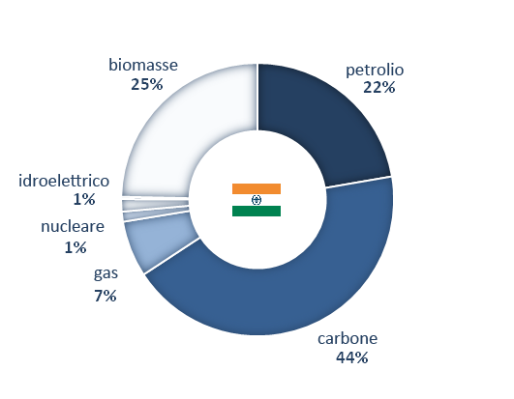
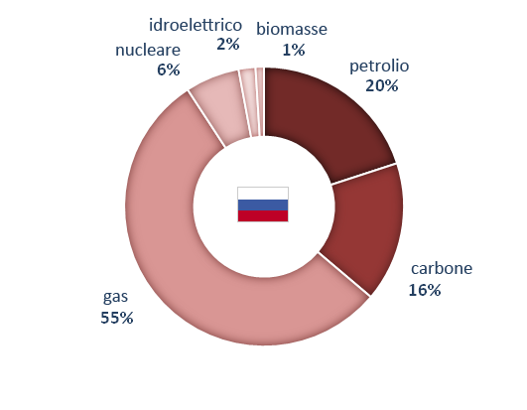
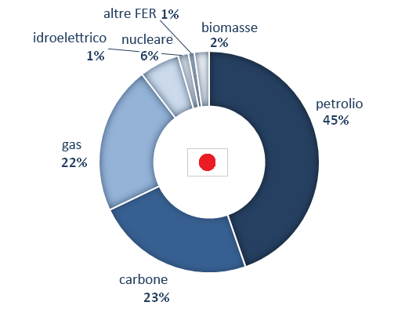
Primary energy consumption
2.743 Mtoe – 88%
2.189 Mtoe – 84%
1.659 Mtoe – 75%
750 Mtoe – 72%
718 Mtoe – 91%
461 Mtoe – 90%
World total: 13.070 Mtoe – Source: IEA, World Energy Outlook 2013 (2011)

Slide 12
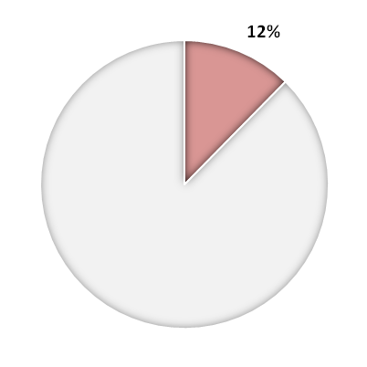
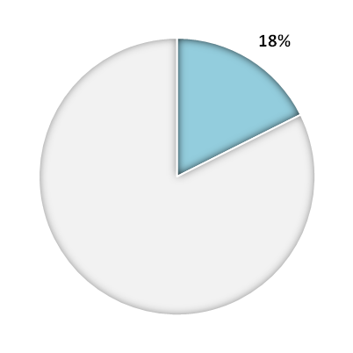
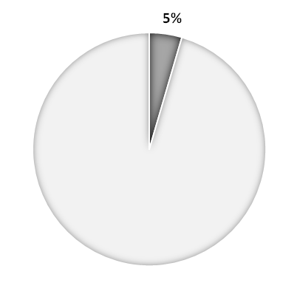
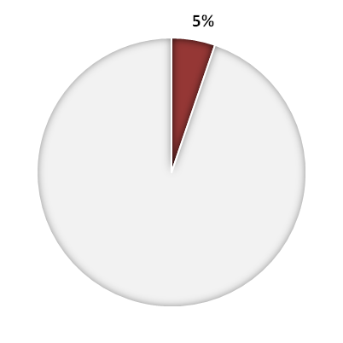
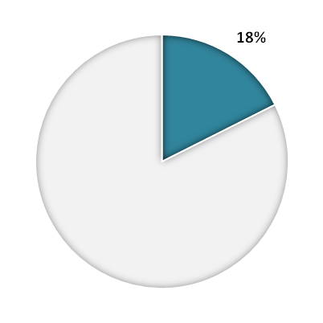
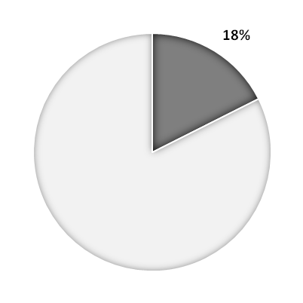
Russian oil and gas production and reserves
Oil
Natural gas
Coal
Production
10,6 Mbbl/d
636 Bcm/y
355 Mt/y
Reserves
87.000 Mbbl
35.000 Bcm/y
157.000 Gt
Source: BP, Statistical Review of World Energy 2013

Slide 13
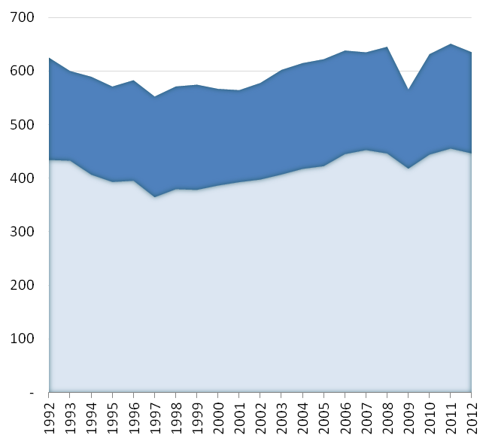
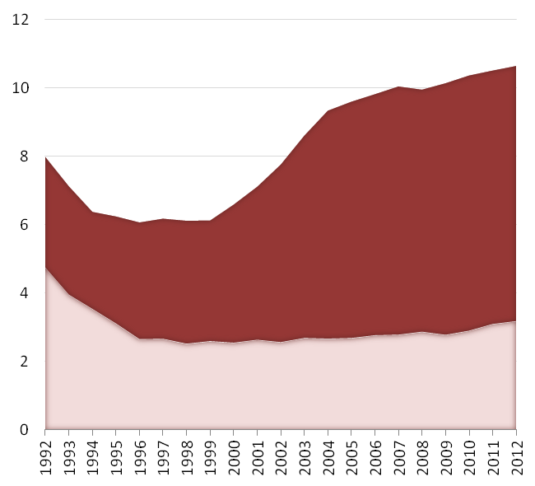
Russian oil and gas production
Natural gas (Bcm/y)
Oil (bbl/d)
Source: BP, Statistical Review of World Energy 2013

Slide 14
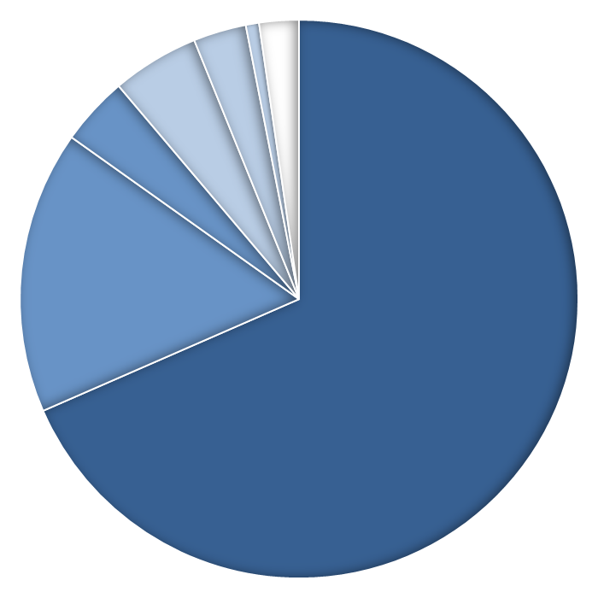
Russian oil and gas production
others (pipeline) - 1%
Belarus
3%
Ukraine
5%
others (LNG) - 2%
Turkey
4%
EU
17%
internal consumption
68%
Includes imports from Central Asia – Source: elaboration on BP, GazpromExport, Eurogas, Eni.

Slide 15
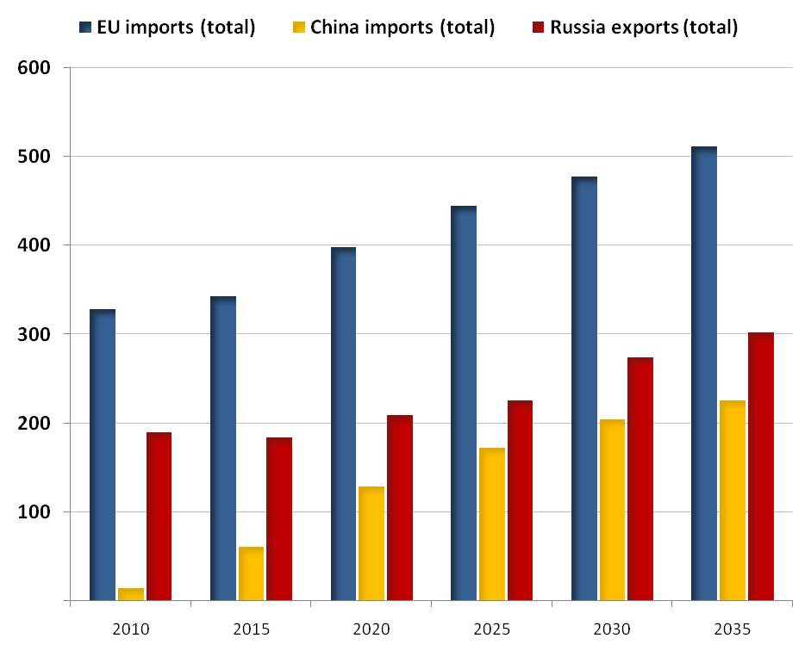
Natural gas trade
Bcm/y
Source: IEA, World Energy Outlook 2012

Slide 16
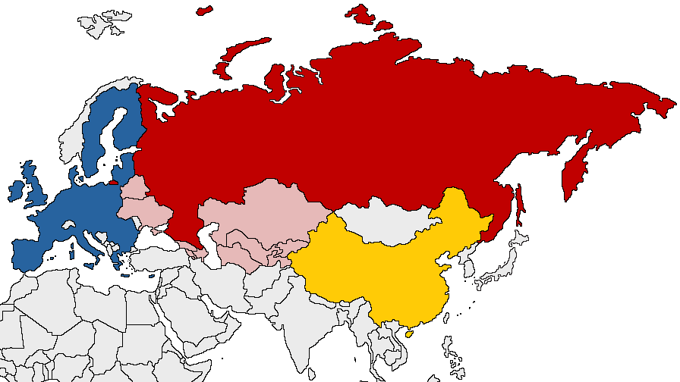
Russian Federation and its partners
© Matteo Verda

Slide 17
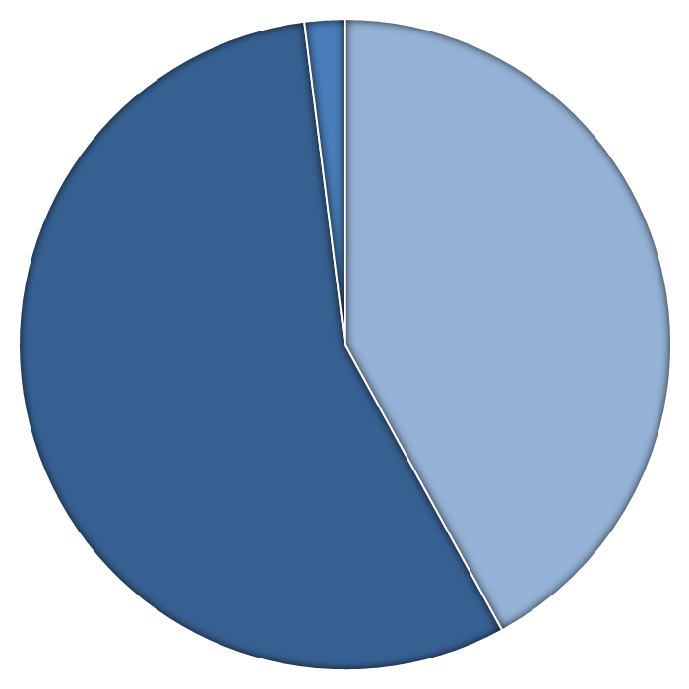
Ukrainian gas supply
storage (-)
2%
1 Bcm
imports
56%
21 Bcm
28 Bcm
domestic production
42%
2013 – Міністерство енергетики та вугільної промисловості України, online database

Slide 18
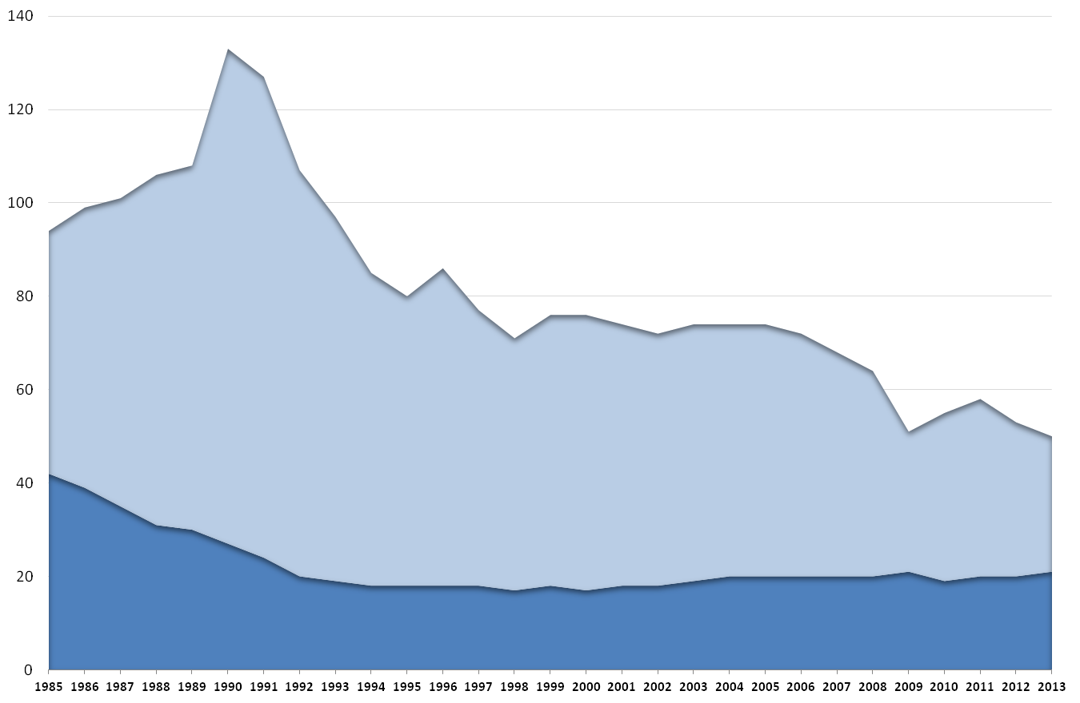
Ukrainian gas supply (1985-2013)
Bcm
imports
production
Elaboration on BP, Statistical Review of World Energy 2013 , and Міністерство енергетики та вугільної промисловості України, online database

Slide 19
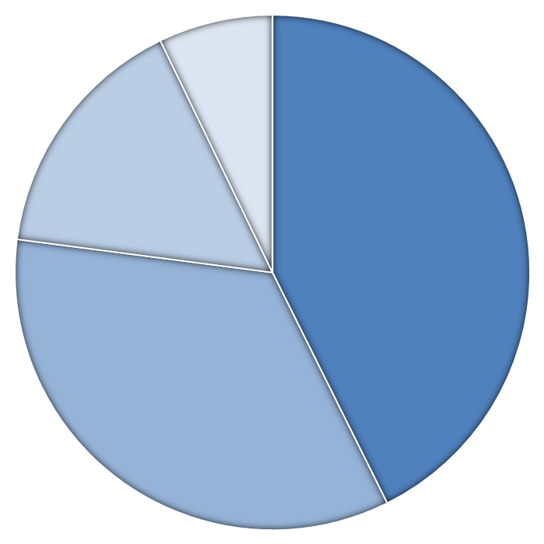
Ukrainian gas consumption per sector
technical - other
7%
district heating companies 16%
4 Bcm
9 Bcm
power sector and industry
43%
23 Bcm
19 Bcm
residential and public sector 34%
2013 – Elaboration on (Pirani 2014)

Slide 20
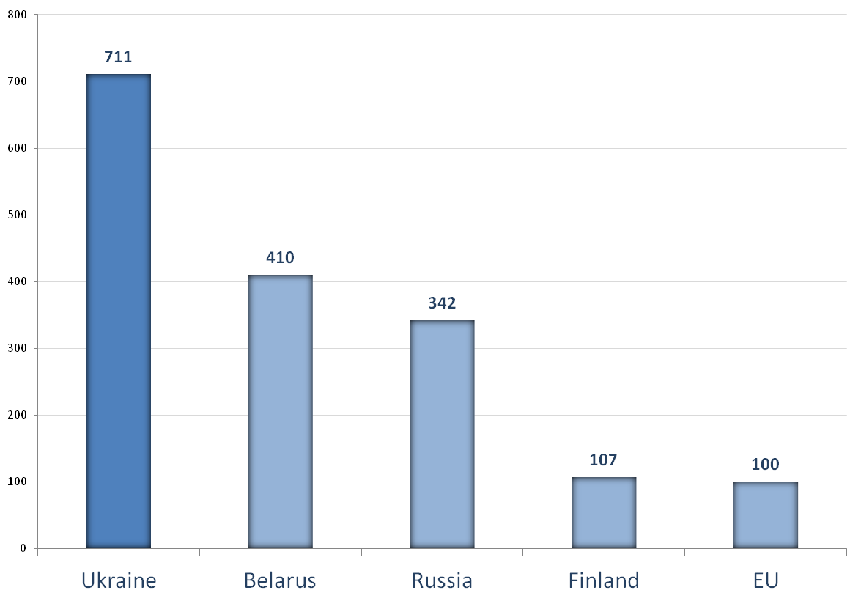
Energy efficiency
tonnes of oil equivalent per million USD
2012 – Elaboration on BP, Statistical Review of World Energy 2013 and IMF, online database

Slide 21
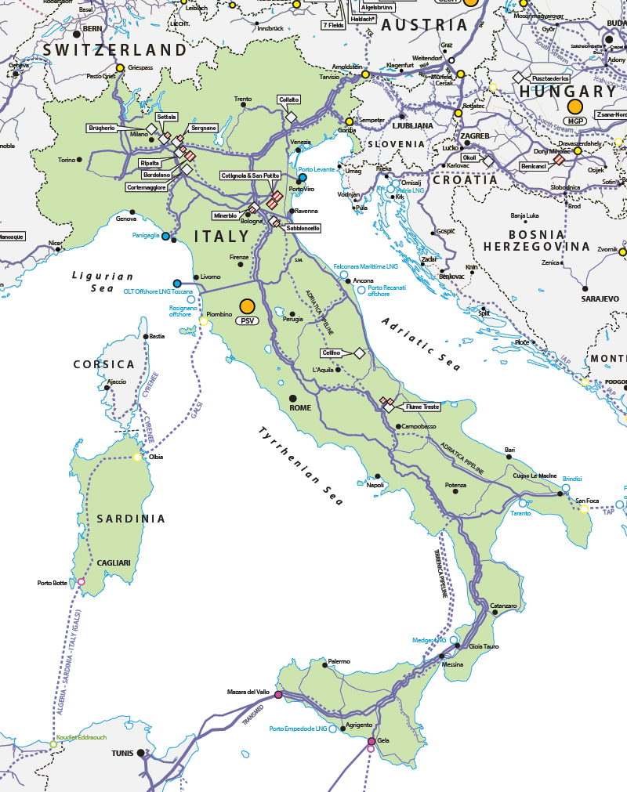
Italian gas system

Slide 22
Contacts
Matteo Verda, Istituto per gli Studi di Politica Internazionale (ISPI) – Milano
mail: matteo.verda@unipv.it
blog: www.sicurezzaenergetica.it
Twitter: @matteoverda
Linkedin: Linkedin/in/matteoverda

